Slide 1

Progressive Overload
A weight training application for Android

Slide 2
Progressive Overload
What is progressive overload?
A weight lifting technique that involves increasing an aspect of your workout every time you perform it.
Increase repetitions
Increase weight
Improve technique

Slide 3
Progressive Overload
How can modern technology help?
Remove the need for recording performance on paper
Display performance in a graphical way
Provide consistent data storage

Slide 4
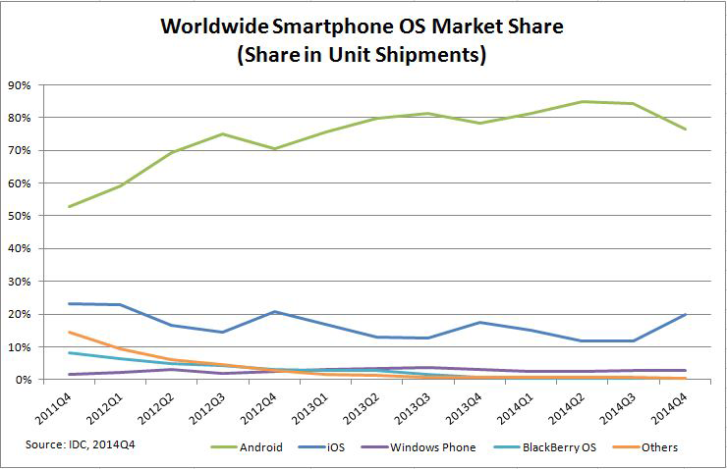
Progressive Overload
Which mobile platform should be used?
www.idc.com
Notes:
Android had the biggest market share
Programmed in java

Slide 5
Progressive Overload
Which mobile platform should be used?
Android is programmed in Java
I have experience in Android Development
Android can be used on many different devices
Notes:
Android had the biggest market share
Programmed in java

Slide 6
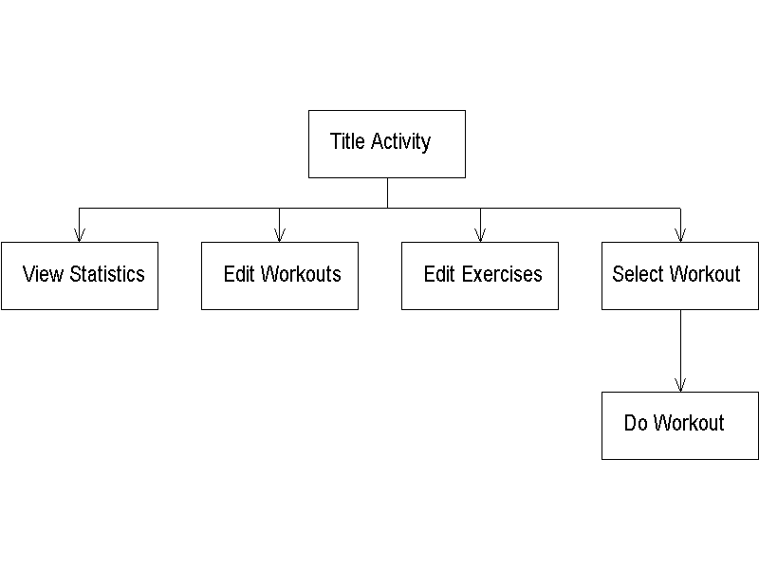
Progressive Overload
GUI Structure
Notes:
Android had the biggest market share
Programmed in java

Slide 7
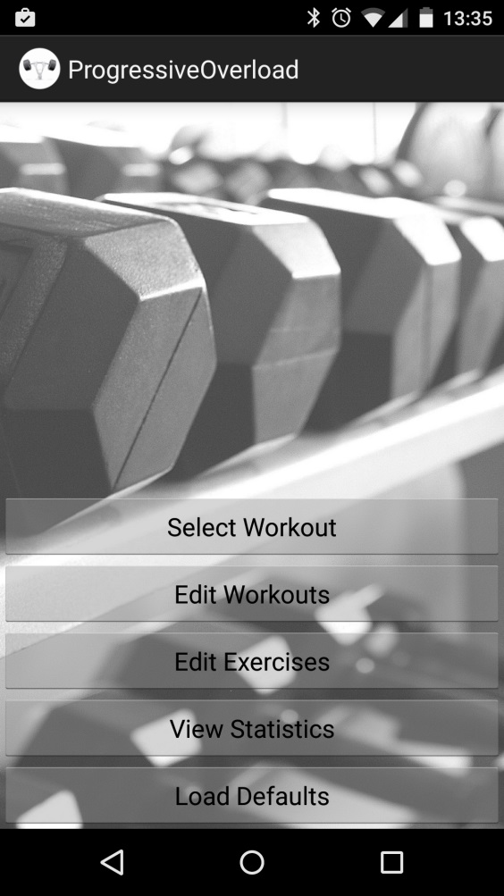
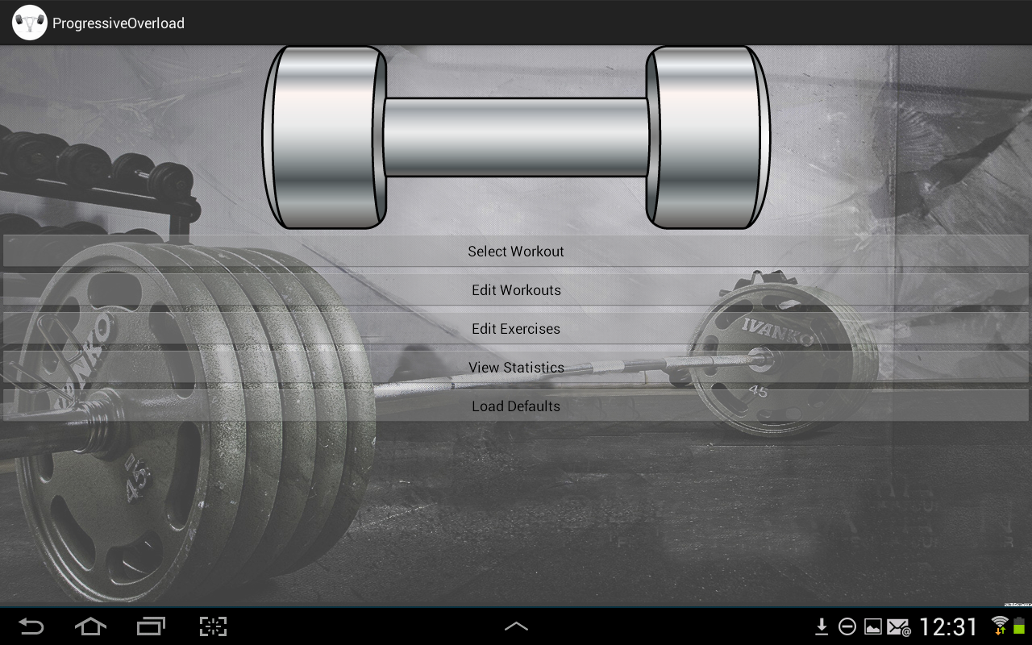
Progressive Overload
GUI Structure
Notes:
Android had the biggest market share
Programmed in java

Slide 8
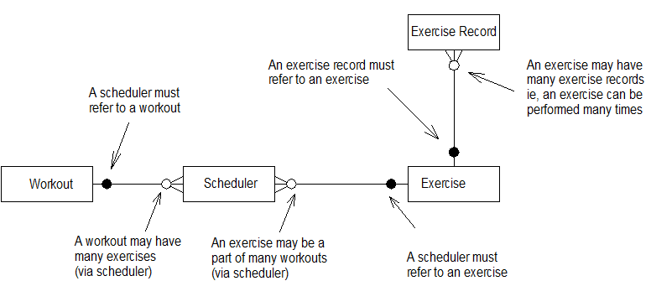
Progressive Overload
Data Storage
Notes:
A database was designed and implemented in SQL

Slide 9
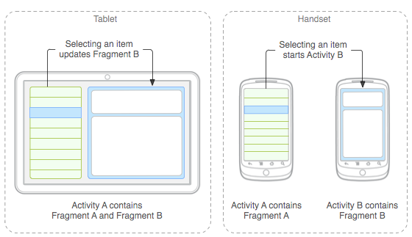
Progressive Overload
GUIs for different devices
www.vogella.com
Notes:
Android had the biggest market share
Programmed in java

Slide 10
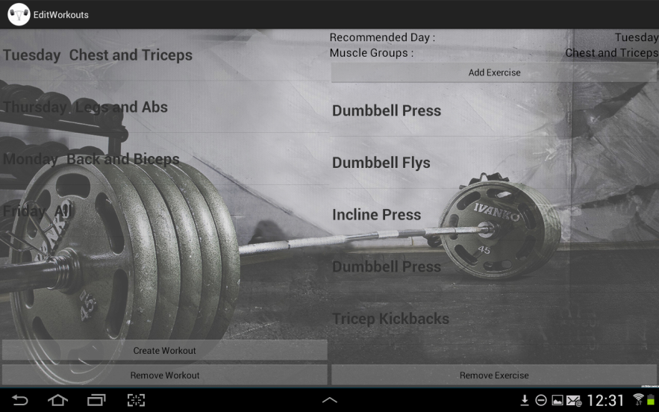
Progressive Overload
GUIs for different devices
Notes:
Android had the biggest market share
Programmed in java

Slide 11
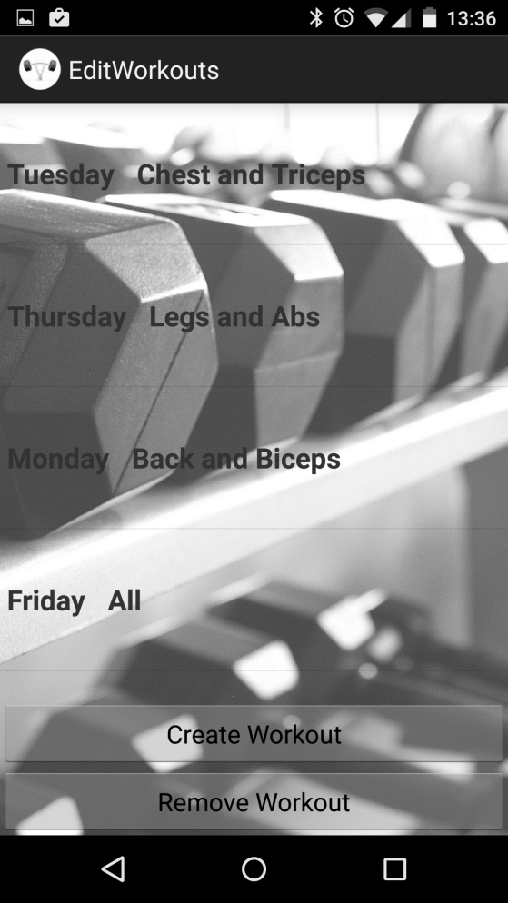
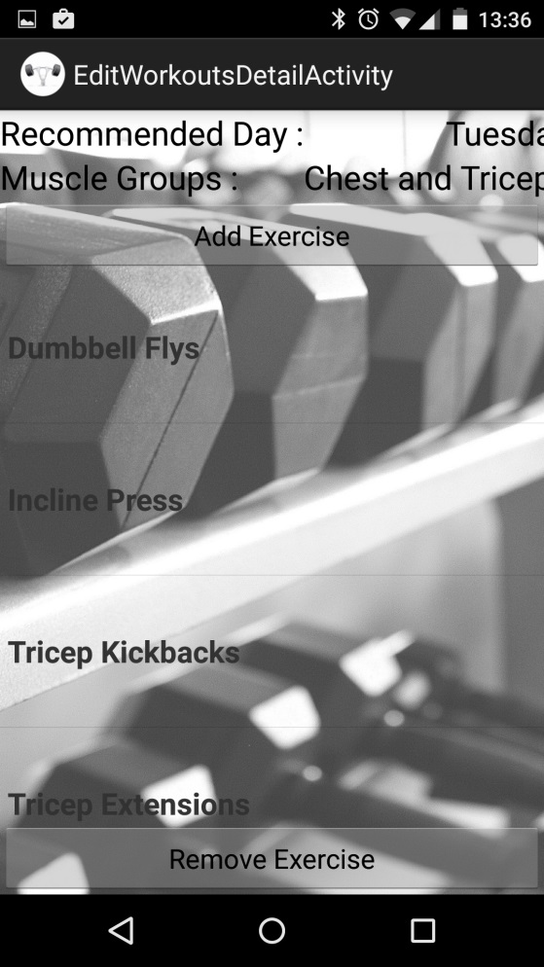
Progressive Overload
GUIs for different devices
Notes:
Android had the biggest market share
Programmed in java

Slide 12
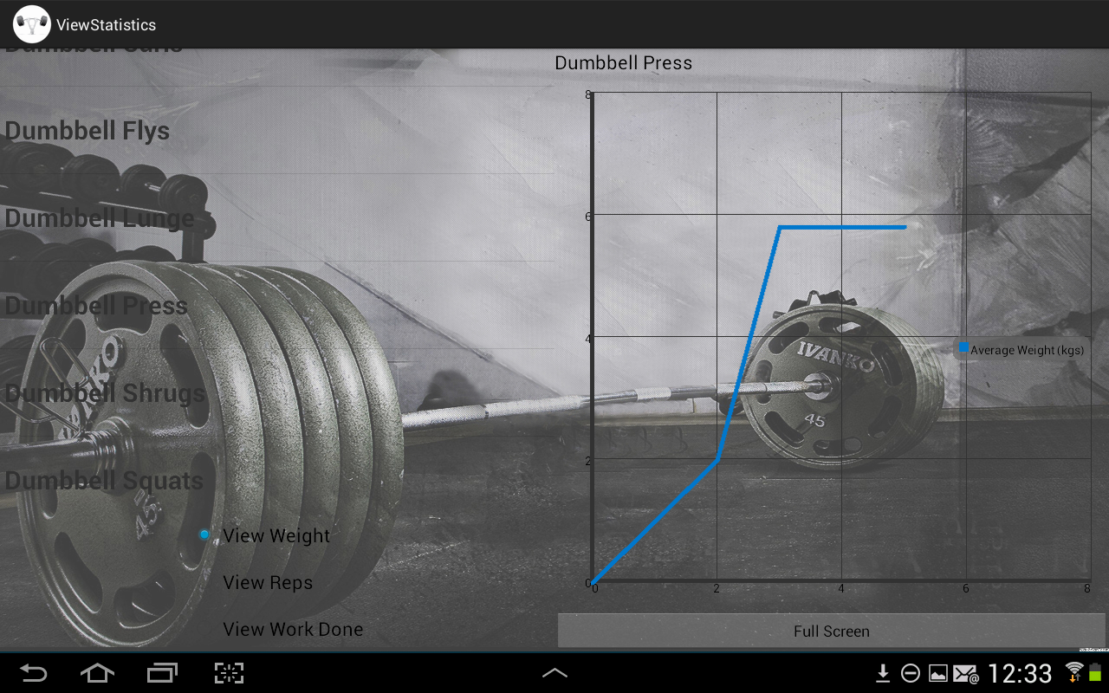
Progressive Overload
Displaying Data
Notes:
Android had the biggest market share
Programmed in java

Slide 13
Progressive Overload
Problems encountered
Using more than one content provider
Android version differences
Image scaling
Notes:
Android had the biggest market share
Programmed in java

Slide 14
Progressive Overload
Future Work
Import / Export data to and from the database
Allow users to compare results
Store data on the cloud rather than locally
Publish to the Android market
Notes:
Android had the biggest market share
Programmed in java

